Slide 1

HP QTP Application Area Prepared by Alpesh Patel

Slide 2
Introduction Application Area
An Application area is a collection of settings and resource files used by components in business process tests.
Each Application area provides a single point of maintenance for all elements associated with the testing of a specific part of the application.
You create application areas to enable Subject Matter Experts to create and run components in business process tests.
Components are automatically linked to all of the resources and settings defined in the associated application area.
Each component can be associated with only one application area.
Application Area resources include Shared Object repositories, function libraries and so on.
You can store resource files of an application area in Quality Center. To do this, you need to connect to a Quality Center.

Slide 3
HP QTP and HP QC/ HP ALM. Connection
Creating Application Area.
Pre Requisite for creating Application Area.
To Create Application one need HP QTP and HP QC/ HP ALM.
Establish Connection between HP QTP and HP QC/ HP ALM.
Make sure you have permissions in HP Quality Center/HP ALM for modifying components, adding steps, modifying steps, and deleting steps. (If you do not have all of these permissions, you can open application areas only in read-only format.).

Slide 4
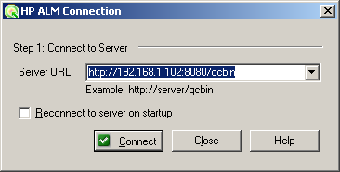
HP QTP and HP QC/ HP ALM. Connection
Establishing Connection between HP QTP and HP QC/ HP ALM from HP QTP
Step 1: Select File->ALM/QC Connection /Optional click ALM/QC Connection button.
HP ALM Connect to server Dialog popup.
Step 2: Connect to server “Server Url: http://192.168.1.102:8080/qcbin”
Step 3: Click Connect Button.

Slide 5
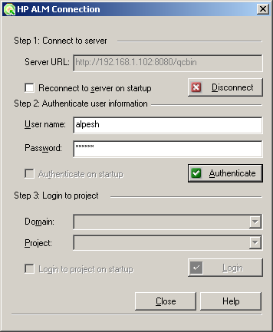
HP QTP and HP QC/ HP ALM. Connection
On clicking Connect Button, HP ALM Connection Dialog popup
Step 4: Authenticate user information using user name and password
User Name: alpesh
Password: alpesh
Step 5: Click Authenticate button.

Slide 6
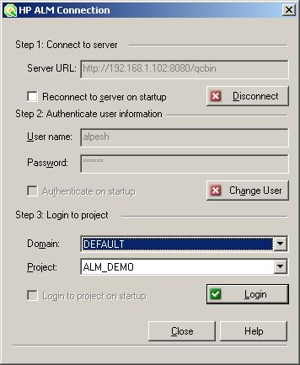
HP QTP and HP QC/ HP ALM. Connection
On clicking Authenticate button Login to Project section gets enable.
Step 6: Login to Project by selecting Domain and Project.
Domain: Default
Project: ALM_DEMO
Step 7: Click Login Button.

Slide 7
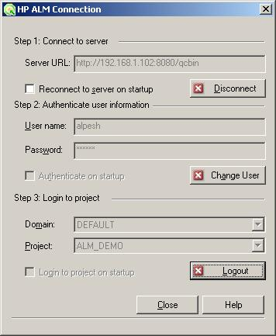
HP QTP and HP QC/ HP ALM. Connection
On clicking Login button QTP establish connection to Default Domain and Project ALM_DEMO. And Logout button gets enabled.
Step 8: Click Close Button.

Slide 8
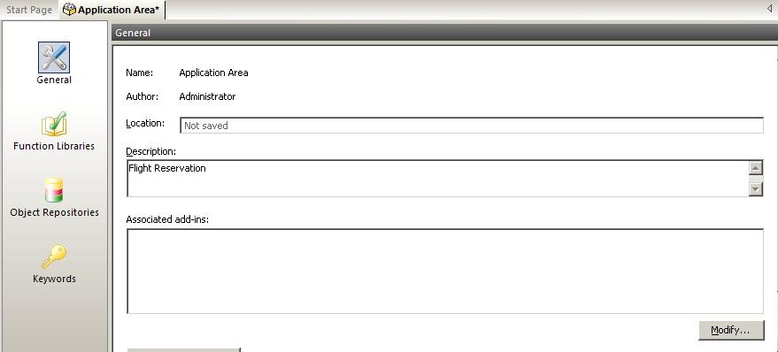
Creating Application Area
Steps to create Application Area.
Step 1: Select File -> New-> Application Area/Select New-> Application Area
Step 2: Enter Description
Step 3: Click Save button.

Slide 9
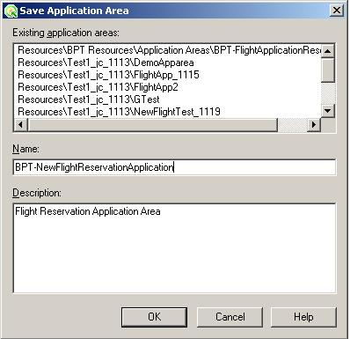
Creating Application Area
On clicking save button Save application Area Dialog box popup.
Step 4: Enter Name of BPT “BPT-NewFlightReservationApplication”.
Step 5: Click Ok Button.

Slide 10
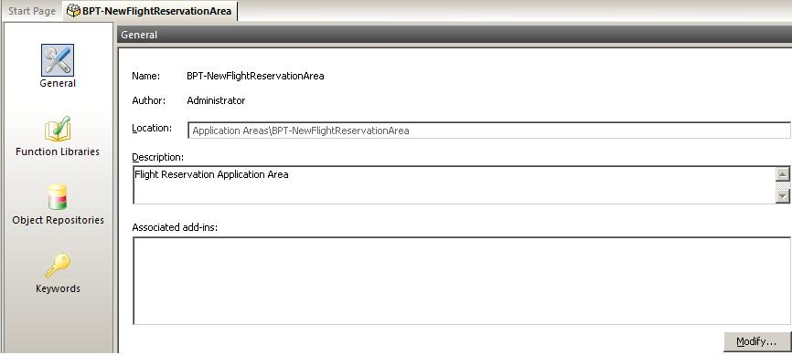
Creating Application Area
On Clicking Ok Button Application Area is created.

Slide 11
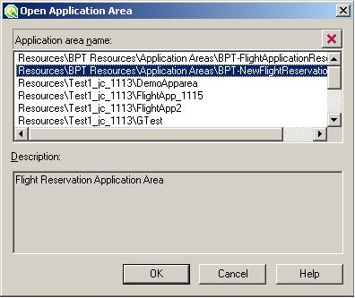
Open existing Application Area
To Open existing Application Area perform following steps.
Step 1: Select File->Open->Application Area/Select Open->Application Area.
Open Application Area popup.
Step 2: Select Application Area to open.
Step 3: Click Ok button.

Slide 12
Open existing Application Area
Clicking Ok button selected Application gets opened.

Slide 13
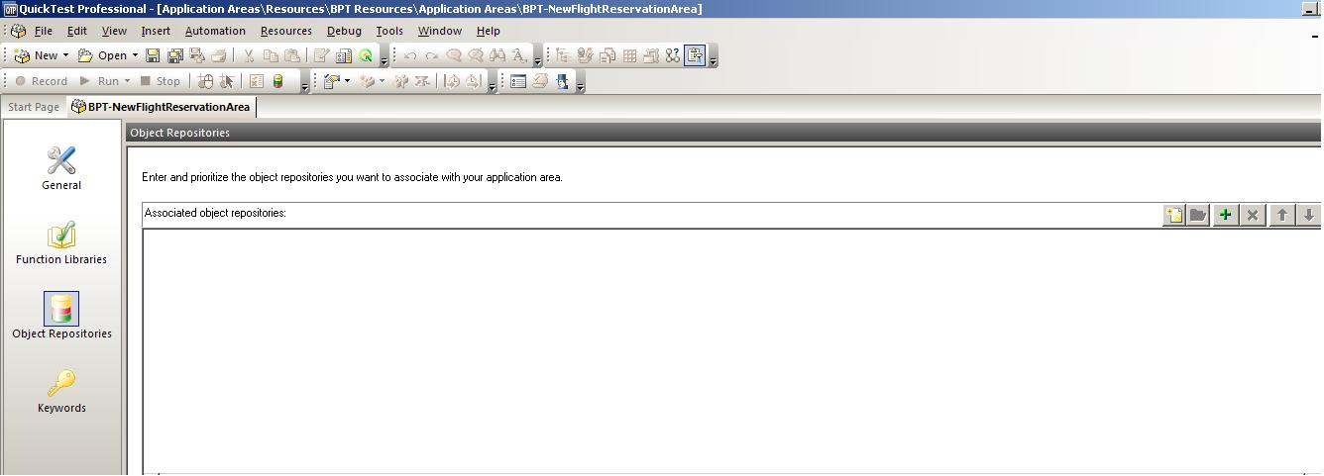
Adding Object Repository
To Associate Object Repository
Step 1: Open Application Area; “BPT-NewFlightReservationArea”
Step 2: Click Object Repositories.
Step 3: Click Add Object Repository button +

Slide 14
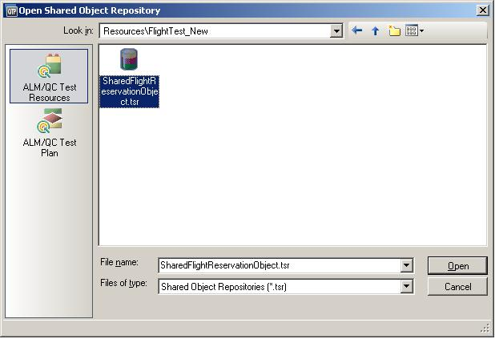
Adding Object Repository
New line is added to Associate Object Repository area.
Step 4: Click Browse button.
“Open Shared Object Repository” File Selection Dialog box popup.
Step 5: Select desired OR to add
Step 6: Click Open button.

Slide 15
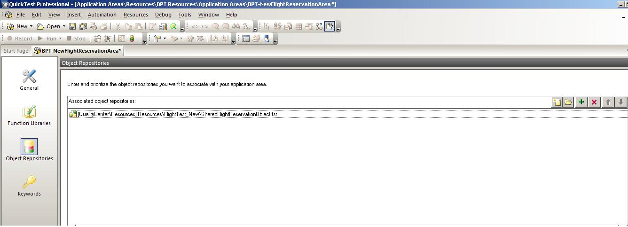
Adding Object Repository
Objected Repository is added to Application Area.
Step 7: Click Save button.
Application area is saved with added OR.

Slide 16
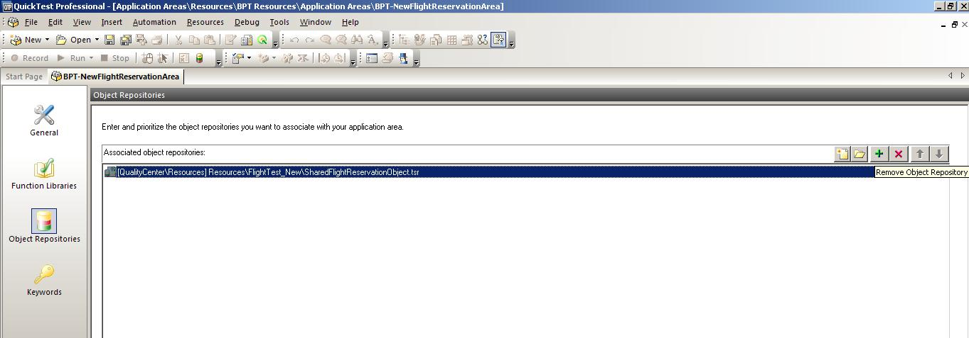
Deleting Object Repository
To Delete Object Repository open Application Area if not opened
Step 1: Click Object Repositories.
Step 2: From the list select desired OR to delete.
Step 3: Click Delete button X
Selected Object Repository will be deleted.

Slide 17
Open/Create Object Repository
To Open/Create Object Repository to Application Area open Application Area if not opened.
Step 1: Click Object Repositories Option under Application Area.
Step 2: Select Create Object Repository button to create new Object Repository.
Step 3: Select Open Object Repository button to Open existing Object Repository.

Slide 18
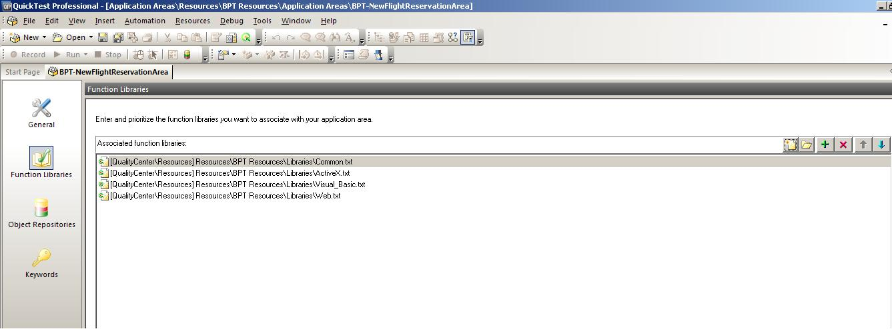
Adding Function Libraries
For Add Function Library to Application Area open Application Area if not opened.
Step 1: click Function Libraries Option under Application Area.
Step 2: Click Add Function Library.

Slide 19
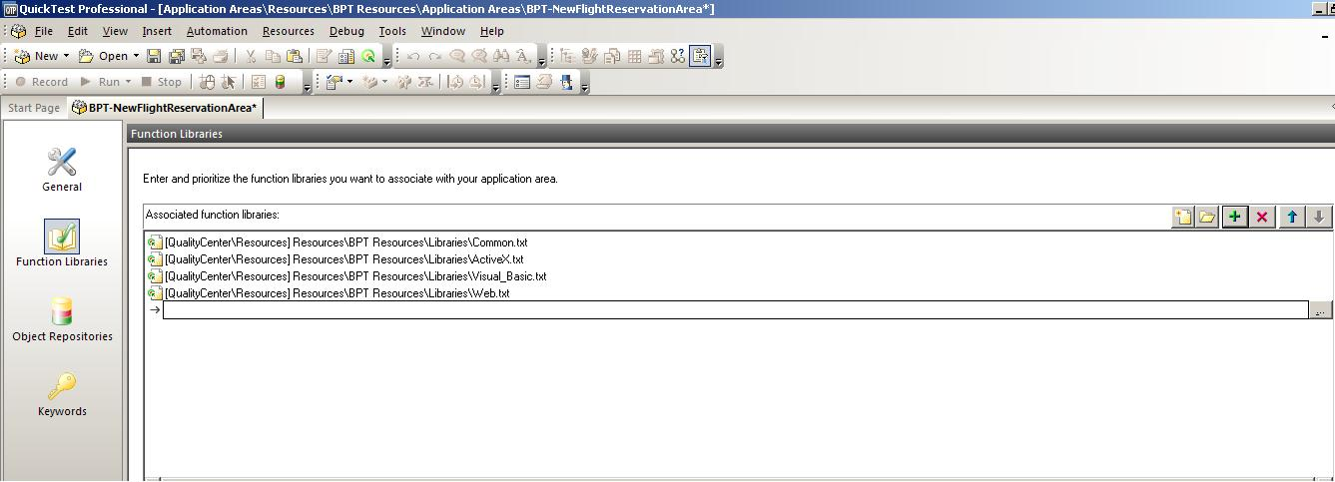
Adding Function Libraries
New line is added under Associated Function Library
Step 3: Click File chooser button.

Slide 20
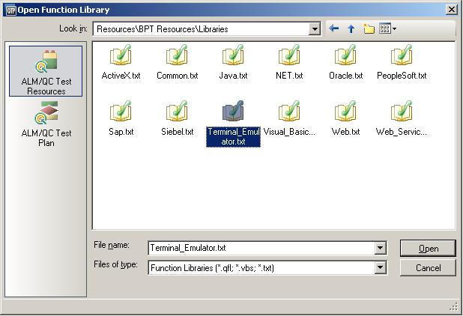
Adding Function Libraries
“Open Function Library” File Chooser Dialog Popup.
Step 4: Select desired function file.
Step 5: Click open button.

Slide 21
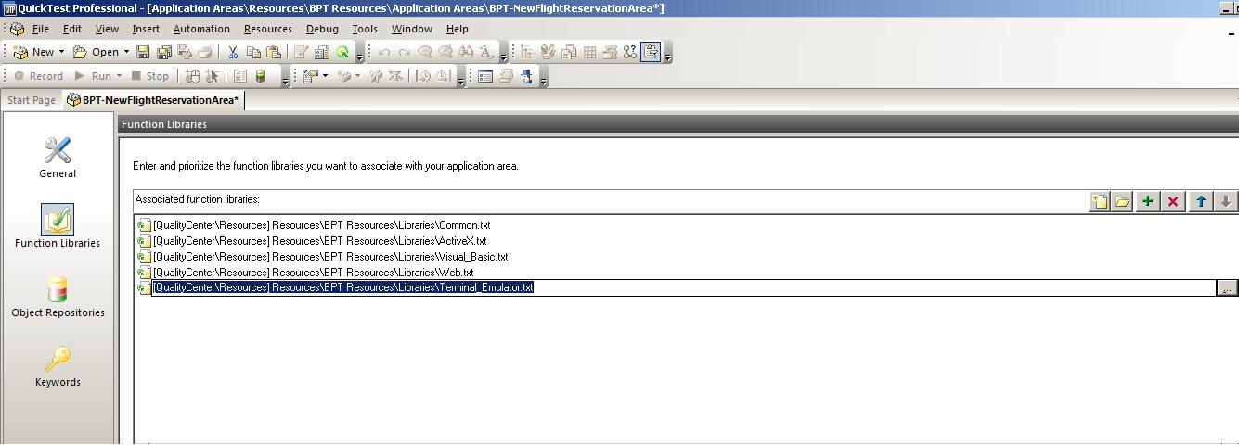
Adding Function Libraries
Selected Library File is added to Associated Function Libraries.
Step 6: Click Save Button.

Slide 22
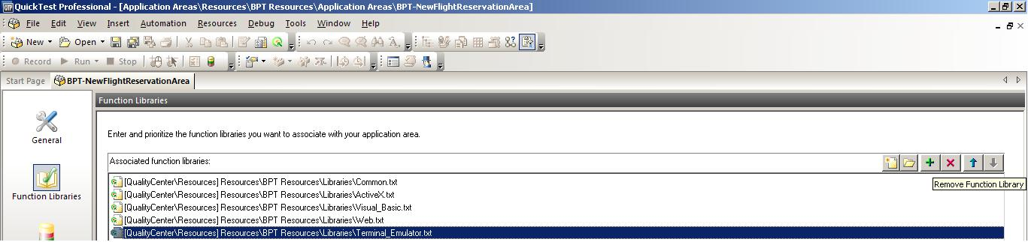
Deleting Function Libraries
For Deleting Function Library to Application Area open Application Area if not opened.
Step 1: Click Function Libraries Option under Application Area.
Step 2: From the list select desired Function Library file to delete.
Step 3: Click Delete button X
Selected Function Library will be deleted.

Slide 23
Open/Create Function Libraries
To Open/Create Function Library to Application Area open Application Area if not opened.
Step 1: Click Function Libraries Option under Application Area.
Step 2: Select Create Function Library button to create new Library.
Step 3: Select Open Function Library button to Open existing Library File.

Slide 24
Question ? Comment Feedback Thanks

